Slide 1
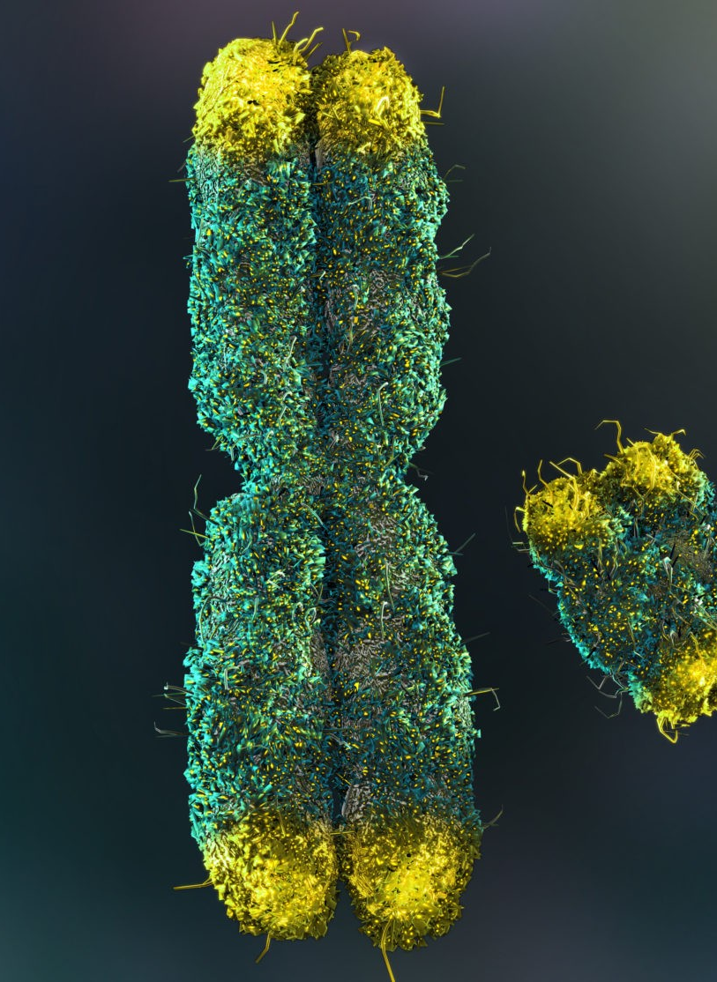
Types of Inheritance:
Sex Linked Traits
AEHBY Human Biology

Slide 2
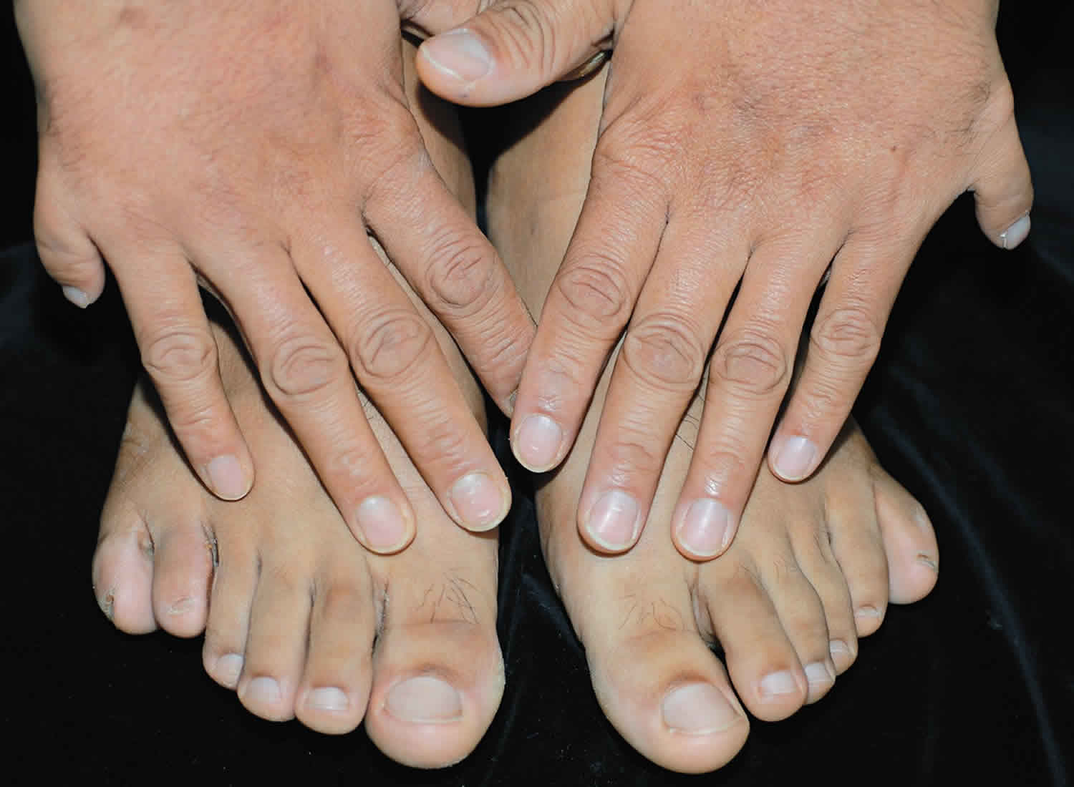
Review
Polydactyly is a dominant allele. Use Punnett squares to explain how it is possible for a parent with polydactyly to have an unaffected child. (4)
Parents with blood types A and B have a child with O blood group. Identify the phenotypes of the parents and use a Punnett square to explain how this is possible. (4)
Using examples, explain the difference between mechanical and chemical digestion (Unit 1). (4)
List four types of biomolecules (macromolecules) and for each name their monomer (Unit 1). (4)

Slide 3
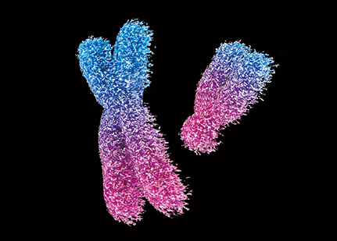
Learning Intentions
Probable frequencies of genotype and phenotype of offspring can be predicted using Punnett squares and by taking into consideration patterns of inheritance, including the effects of sex-linked alleles.

Slide 4
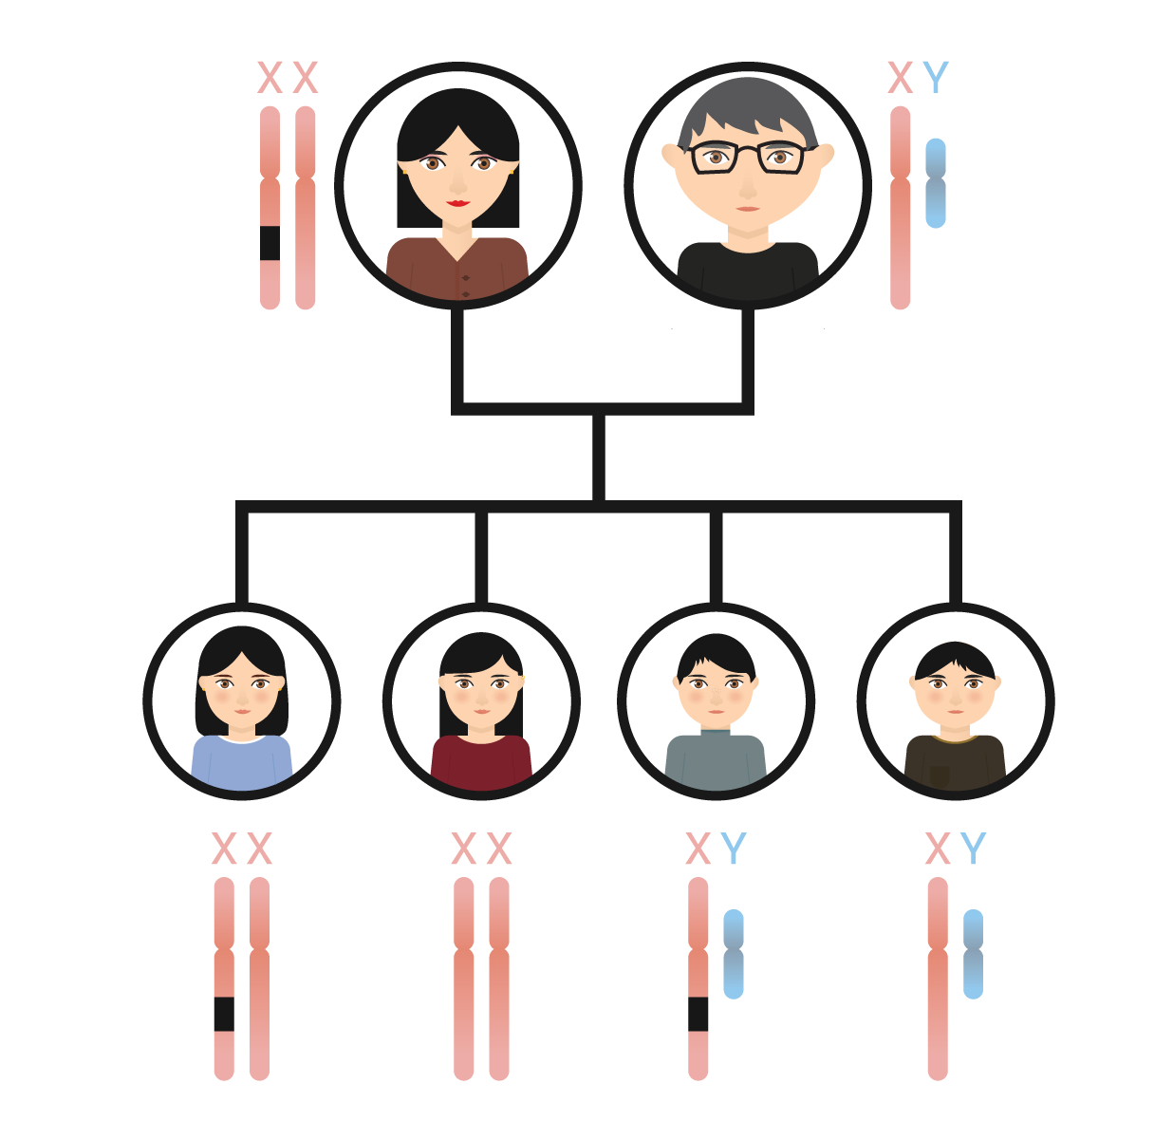
Success criteria
Define sex-linkage in terms of alleles, inheritance patterns, genotype and phenotype.
Give examples of sex linked traits.
Distinguish between X dominant, X recessive and Y inheritance.
Use Punnett squares to represent monohybrid crosses involving X-linked traits.

Slide 5
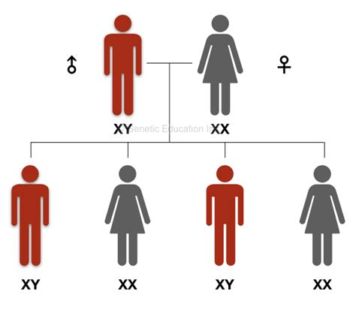
Sex chromosomes and sex-linked conditions
In humans there are 44 non-sex autosomal chromosomes (22 pairs) and 2 sex chromosomes (XX or XY). As well as traits relating to sex, both the X and Y chromosomes carry other genes, which are sex linked.

Slide 6
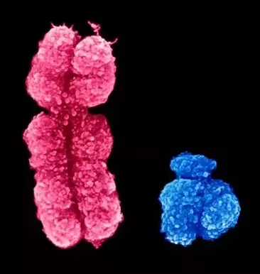
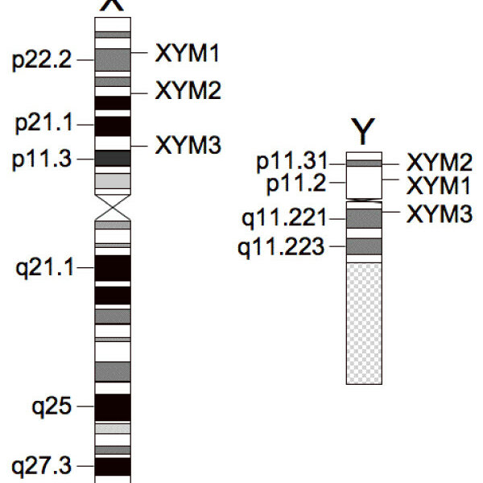
The X chromosome is much longer than the Y chromosome.
Some genes on the X chromosome have no corresponding gene on the Y chromosome.

Slide 7
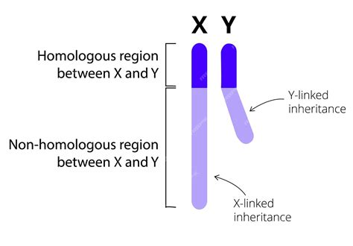
Recombination or “crossing over” does not occur between the X and Y, because they are not fully homologous.

Slide 8
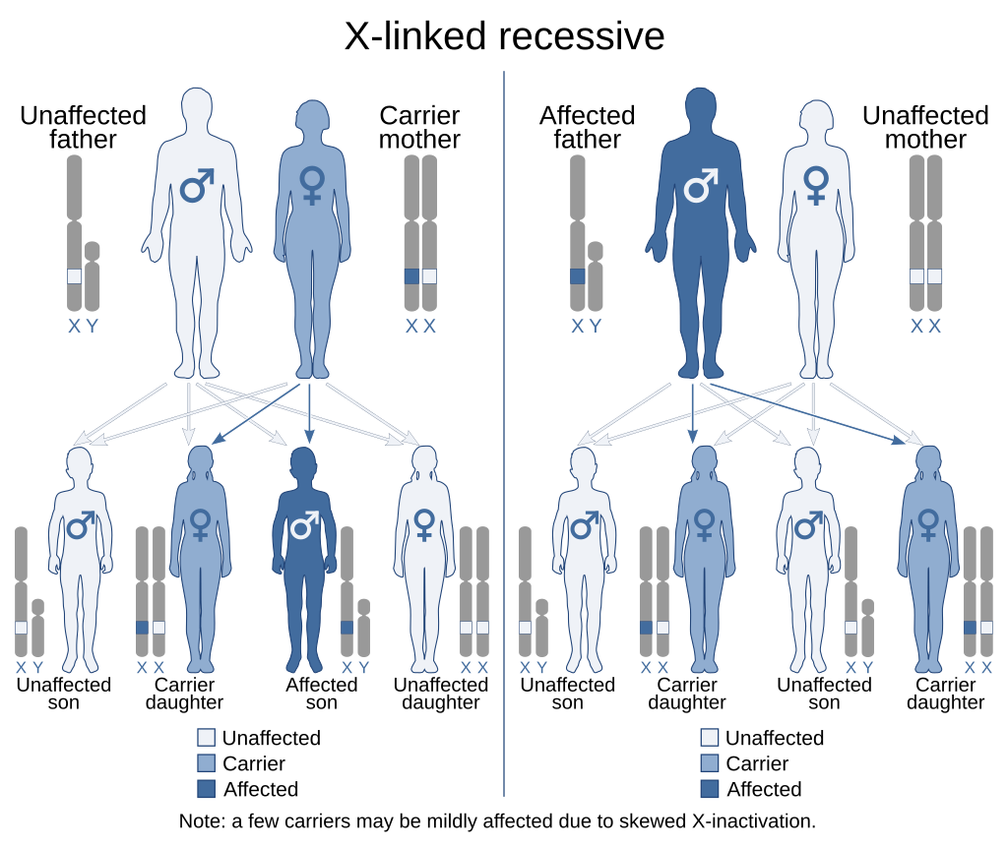
X-linked Recessive Inheritance
Carried on the X chromosome, the phenotype is always expressed in males (homozygous because they have only one X) and in homozygous females (two recessive Xs). Heterozygous females are carriers.

Slide 10
Alleles, genotypes and phenotypes
X : normal X
Xª : affected X
Y: a Y chromosome
XX: normal female XªX: carrier female
XªXª: affected female
XY: normal male XªY: affected male

Slide 11
Red green colour-blindness
The gene for red-green colour-blindness is carried on the X chromosome and is recessive. This means that a female would need to have two affected genes to have the condition, but a male needs to only have one affected gene.
Sex linked conditions are much more common in males than females.

Slide 12
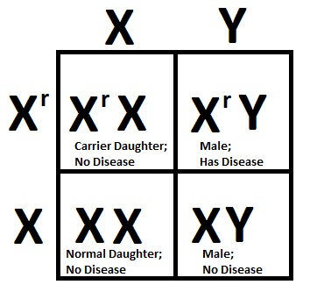
Example:
A woman whose father was red-green colourblind had children with an unaffected man.
Determine the possible genotypes and phenotypes of the children.
Mother X^{r}X Father XY

Slide 13
Ishihara Test | Color Test | Ishihara Chart (colorblindnesstest.org)

Slide 14
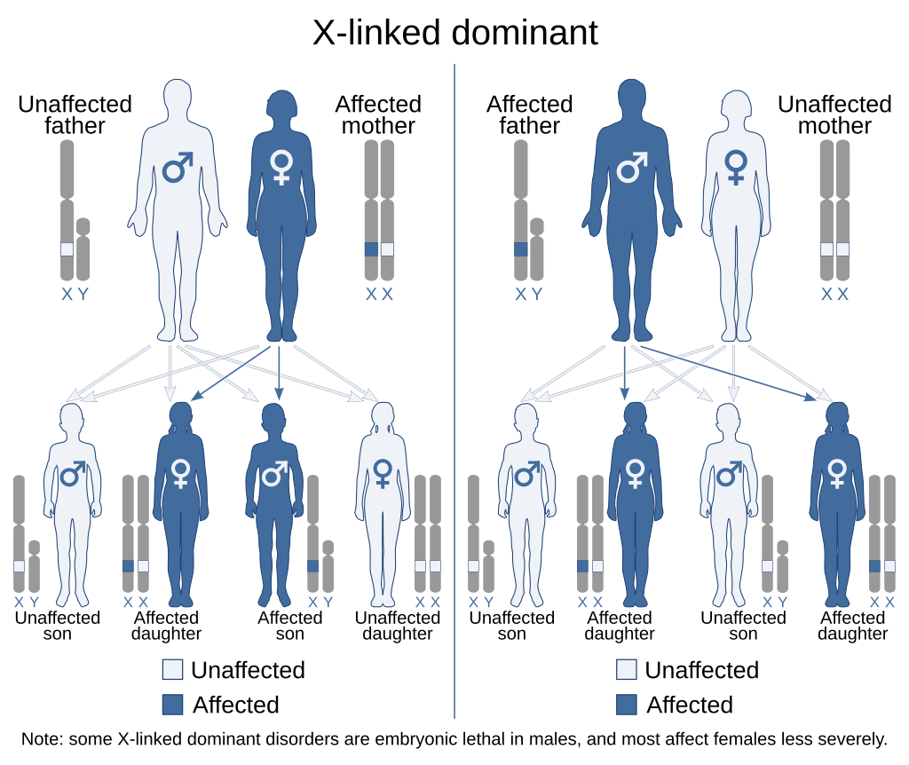
X dominant traits
Only one copy of the dominant gene is required to be expressed in the genotype, so very similar inheritance to autosomal dominant-recessive patterns.

Slide 15
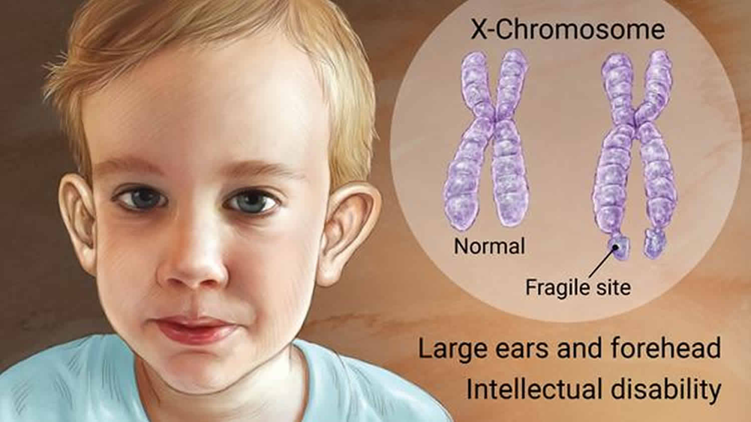
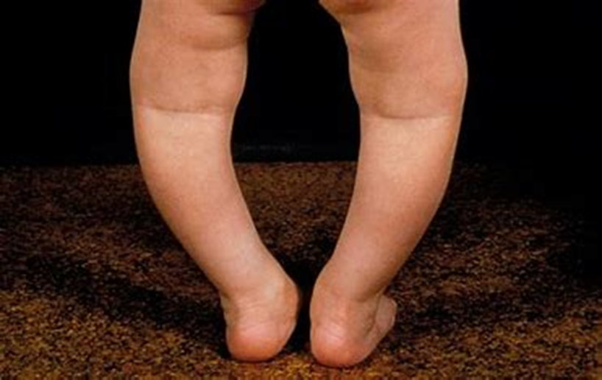
Fragile X syndrome
Vitamin D resisitant Rickets

Slide 16
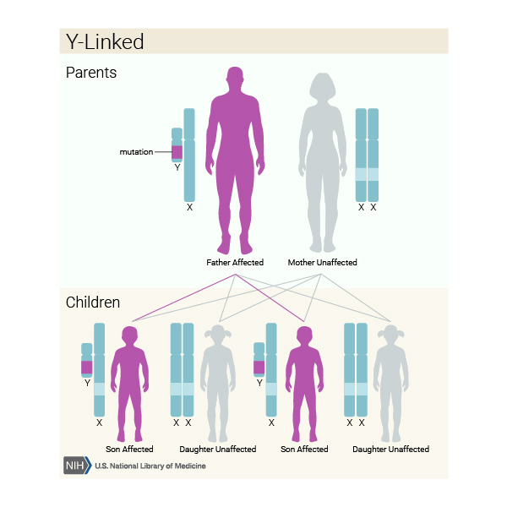
Y traits
There are no dominant or recessive traits, as only one allele is ever present and only males can inherit conditions from their affected fathers.

Slide 17

Swyer Syndrome

Slide 18
Success criteria
Define sex-linkage in terms of alleles, inheritance patterns, genotype and phenotype.
Give examples of X-linked traits.
Use Punnett squares to represent monohybrid crosses involving X-linked traits.

